Slide 1
Quote extraction automation API APR’ 22 – JUNE’ 22
KUNAL SACHDEV
LAVISHA GEHANI

Slide 2
AGENDA
Objective
Current Process
Challenges with Current Process
Modified Process
Advantages of Modified Process
Managing Redundancy in Lead ID
Products
API Code Flow
Demo
Software Specifications
Acknowledgements

Slide 3
objective
Create an API to automate the process of validation, extraction, and storage of data from Insurance Quote Excel into Database, thereby removing manual data entry and expediting the policy issuance process.

Slide 4
Current process
1
2
3
Salesperson fills customer and risk details into excel sheet
Salesperson sends filled excel back to UW for quote calculation and approval
UW provides Salesperson the quotation excel template
6
5
4
Salesperson submits cheque
along with quote sheet to the operations team
Salesperson tells customer the calculated quote and collects cheque
UW calculates quote and sends
it to salesperson
7
8
Operations team manually
enters data from excel sheet into front-end application
Operations team issues the
policy

Slide 5
challenges with current process
Excel quote template inconsistency:
Salesperson might have changed some formulas in the excel sheet.
Salesperson might be using the obsolete template.
Time consuming: Manual data entry from excel into application for policy issuance.
Manual Data Entry is error prone.

Slide 6
modified process
1
2
3
Salesperson fills customer and risk details into excel sheet
Salesperson sends filled excel back to UW for quote calculation and approval
UW provides Salesperson the quotation excel template
6
5
4
Salesperson submits cheque along with quote sheet to the application
Salesperson tells customer the calculated quote and collects cheque
UW calculates quote and sends it to salesperson
7
8
Application calls API; api validates the quotation template, extracts the data,
and populates the database.
Operation team issues
the policy

Slide 7
Advantages of Modified process
4 Factor Validation:
File is in .xlsx format
Checks for unique hidden encrypted value in a random cell in excel file
Checks for template format using 5 constant labels in the right cells in excel sheet e.g. hazard category, natcat score, graded retention, mailing address, and occupancy.
Checks for the creator and title of the sheet from sheet properties.
Automated Data Entry from Excel to Database:
Saves time:
Current Process – At least 2 hours to generate 1 proposal
Modified Process – At most 2 minutes to generate 1 proposal
No Data entry errors

Slide 8
Managing Redundancy in lead id
Whenever a customer reaches out to the insurance company for buying a product, a unique lead is created for that customer, which includes his/her basic details.
It could happen that the same customer uploads the same excel file twice or thrice to out api, leading to multiple entries of records with the same lead id.
So how to deal with this redundancy problem?
We have created an “isactive” column in each table in the database. Whenever data is uploaded into the database, the api first checks if that lead id already exists. If it does, the “isactive” column of all previous records with that lead is made 0, and the new incoming records get the lead id 1. In this way, the company knows that the customer’s most recent activity are the records that have the lead id as 1.

Slide 9
Products
For each Product the following sections were read:
Customer Details
Main Policies
Add-On Covers
Terms & Conditions
Deductibles, Warranties, Clauses & Conditions
Exclusions & Subjectivities
Supplementary Clauses & Conditions
Standard Fire & Special Perils Policy (SFSP)
Burglary Insurance
Plate Glass Insurance

Slide 10
API Code flow
FILE UPLOAD
QUOTE FORMAT VALIDATION
QUOTE EXTRACTION
START
N
Establish Connection
Check File Format
API CALL
Y
Create DataFrames
N
Check Constant Sheet Values
N
Y
Y
UPLOAD FILE
Upload Data to DataFrame
N
Y
Y
Check Field Properties
END
N

Slide 11
demo

Slide 12
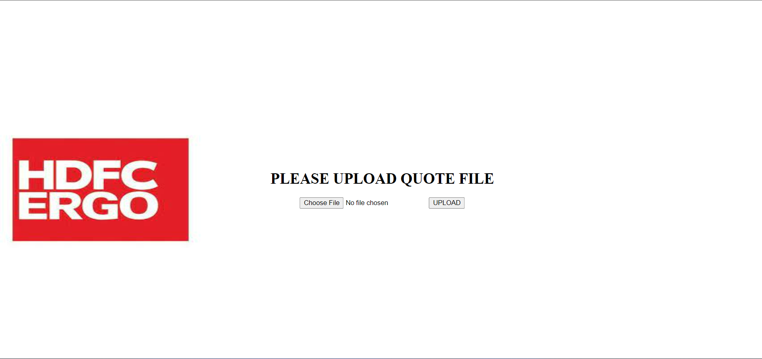
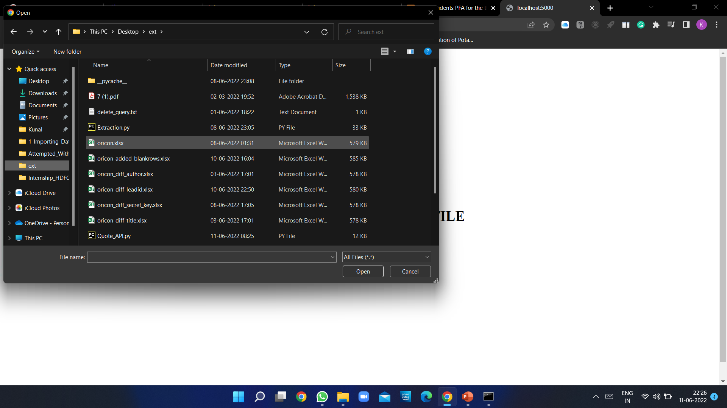
Demo
Front-end to upload quote excel file
Select the quote file & submit
Output message

Slide 13
Software specifications
Python – 3.8.8 with Oracle – 19c as Database
Flask – 2.1.2
Pandas – 1.4.2
NumPy – 1.22.4
Os – 0.6.3
Sqlalchemy – 1.3.24 (Using this version is critical as some of the functions for executing queries using python from this version are deprecated in higher versions)
Openpyxl – 3.0.9
Werkzeug – 2.1.2
Cx_Oracle – 8.3.0

Slide 14
acknowledgements
We would like to express our gratitude to Senior VP-IT Mr. Naresh Jha & HDFC ERGO, who gave us this golden opportunity to do this wonderful project of Quote Extraction Automation API. We learned many new concepts in python and SQL programming, which have added to our skillset and have helped us grow. Secondly, we would also like to thank our mentors Mr. Ketan Khandagale and Mr. Swapnil Gunjal for assisting us in completing this project and providing help and support at every step of the project. Lastly, we would also like to thank our parents for helping us finalize this project within the stipulated time frame. We are grateful for getting this opportunity. Thank you.

Slide 15
THANK YOU

